Slide 1


ML/DL for Everyone with
Lecture 5: Linear regression
in PyTorch way

Slide 2
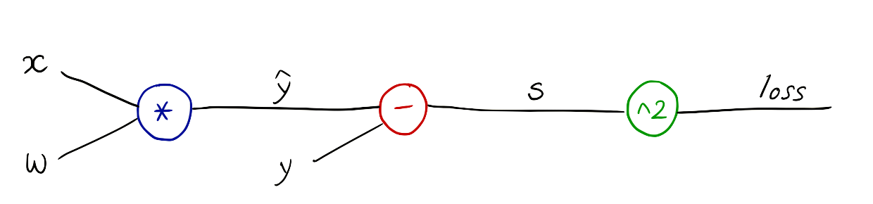
PyTorch forward/backward
w = Variable(torch.Tensor([1.0]), requires_grad=True) # Any random value
# our model forward pass
def forward(x):
return x * w
# Loss function
def loss(x, y):
y_pred = forward(x)
return (y_pred - y) * (y_pred - y)
# Training loop
for epoch in range(10):
for x_val, y_val in zip(x_data, y_data):
l = loss(x_val, y_val)
l.backward()
print("\tgrad: ", x_val, y_val, w.grad.data[0])
w.data = w.data - 0.01 * w.grad.data
# Manually zero the gradients after updating weights
w.grad.data.zero_()
print("progress:", epoch, l.data[0])
Notes:
loss = (\hat{y}-y)^2 = (x*w-y)^2
\frac{\partial{loss}}{\partial{w}}=?

Slide 3



PyTorch Rhythm
Design your model using class with Tensors
Construct loss and optimizer
(select from PyTorch API)
Training cycle
(forward, backward, update)

Slide 4

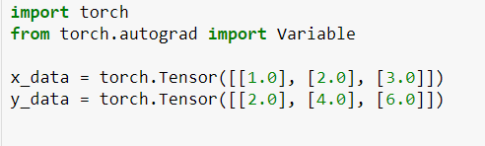
Data definition (3x1)

Slide 5
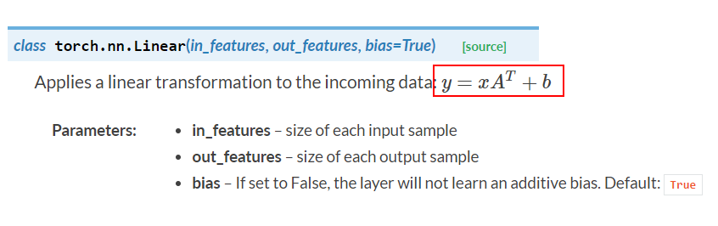
Use PyTorch’s Linear Module

Slide 6
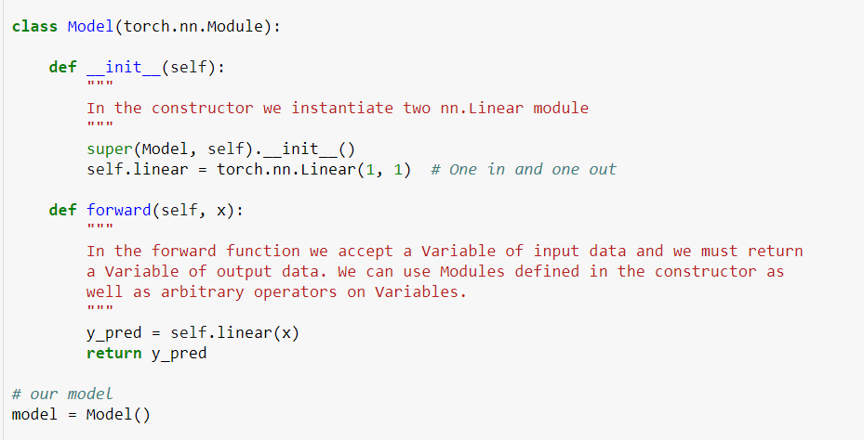
Model class in PyTorch way

Slide 7
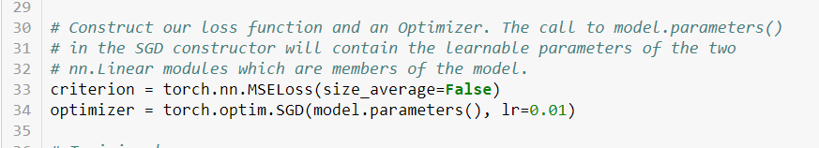
Construct loss and optimizer
https://github.com/jcjohnson/pytorch-examples

Slide 8
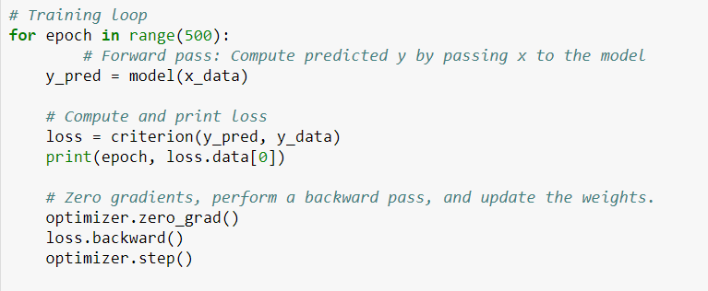
Training: forward, loss, backward, step
https://github.com/jcjohnson/pytorch-examples

Slide 9
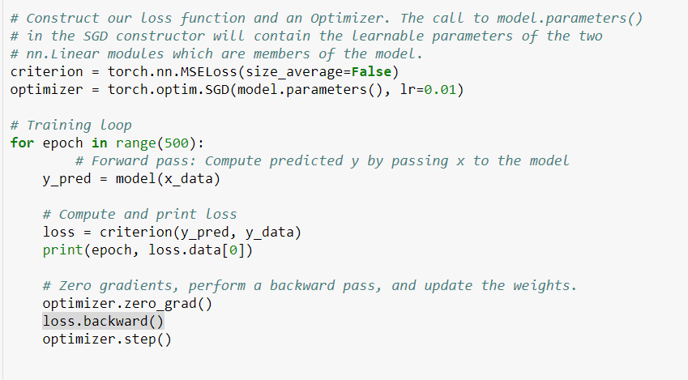
Training: forward, loss, backward, step
for x_val, y_val in zip(x_data, y_data):
...
w.data = w.data - 0.01 * w.grad.data
https://github.com/jcjohnson/pytorch-examples

Slide 10
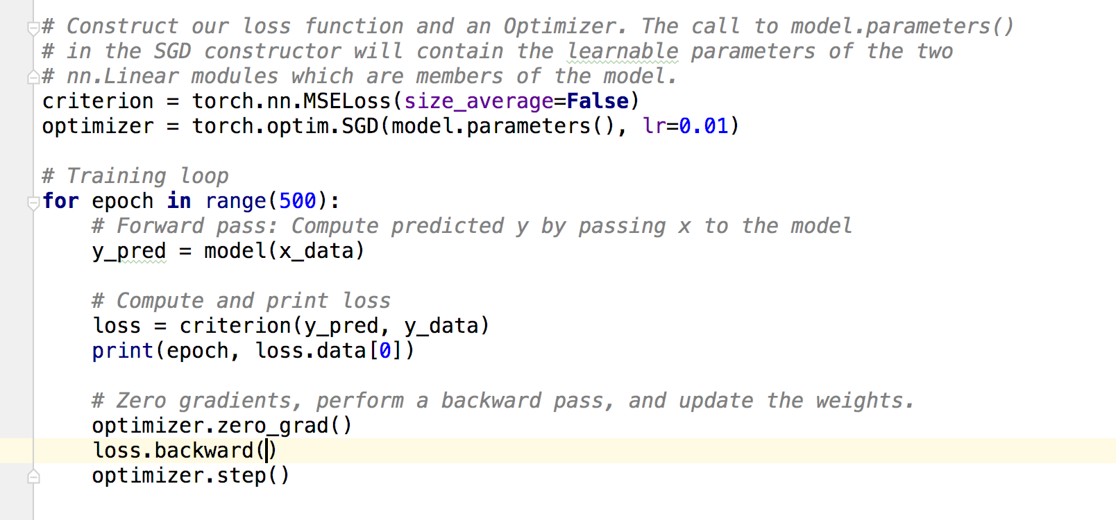
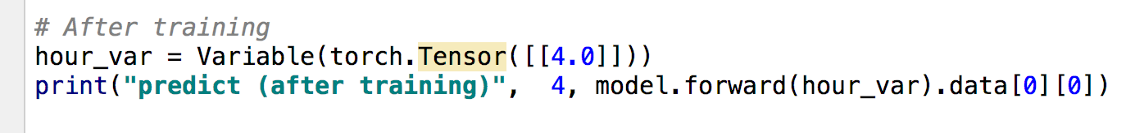
Testing Model
https://github.com/jcjohnson/pytorch-examples

Slide 11
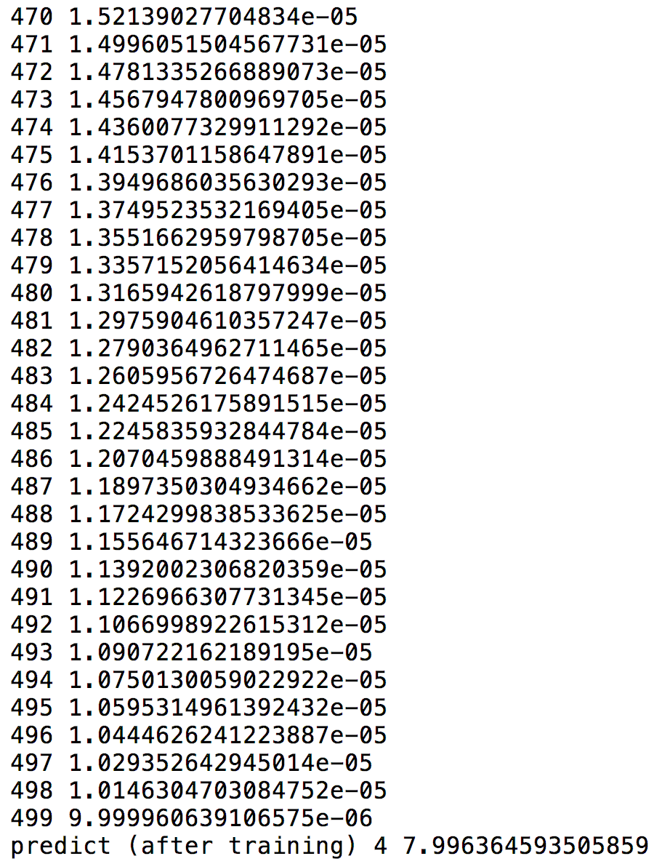
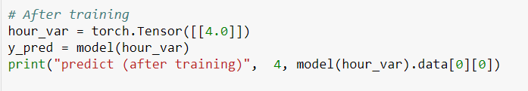
Output
https://github.com/jcjohnson/pytorch-examples

Slide 12
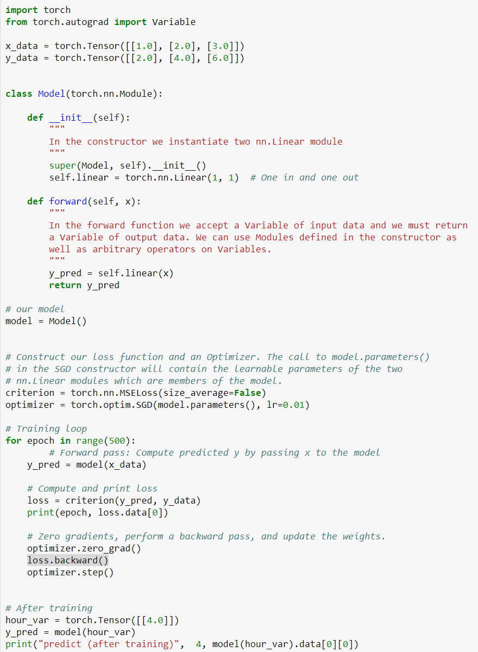

Slide 13
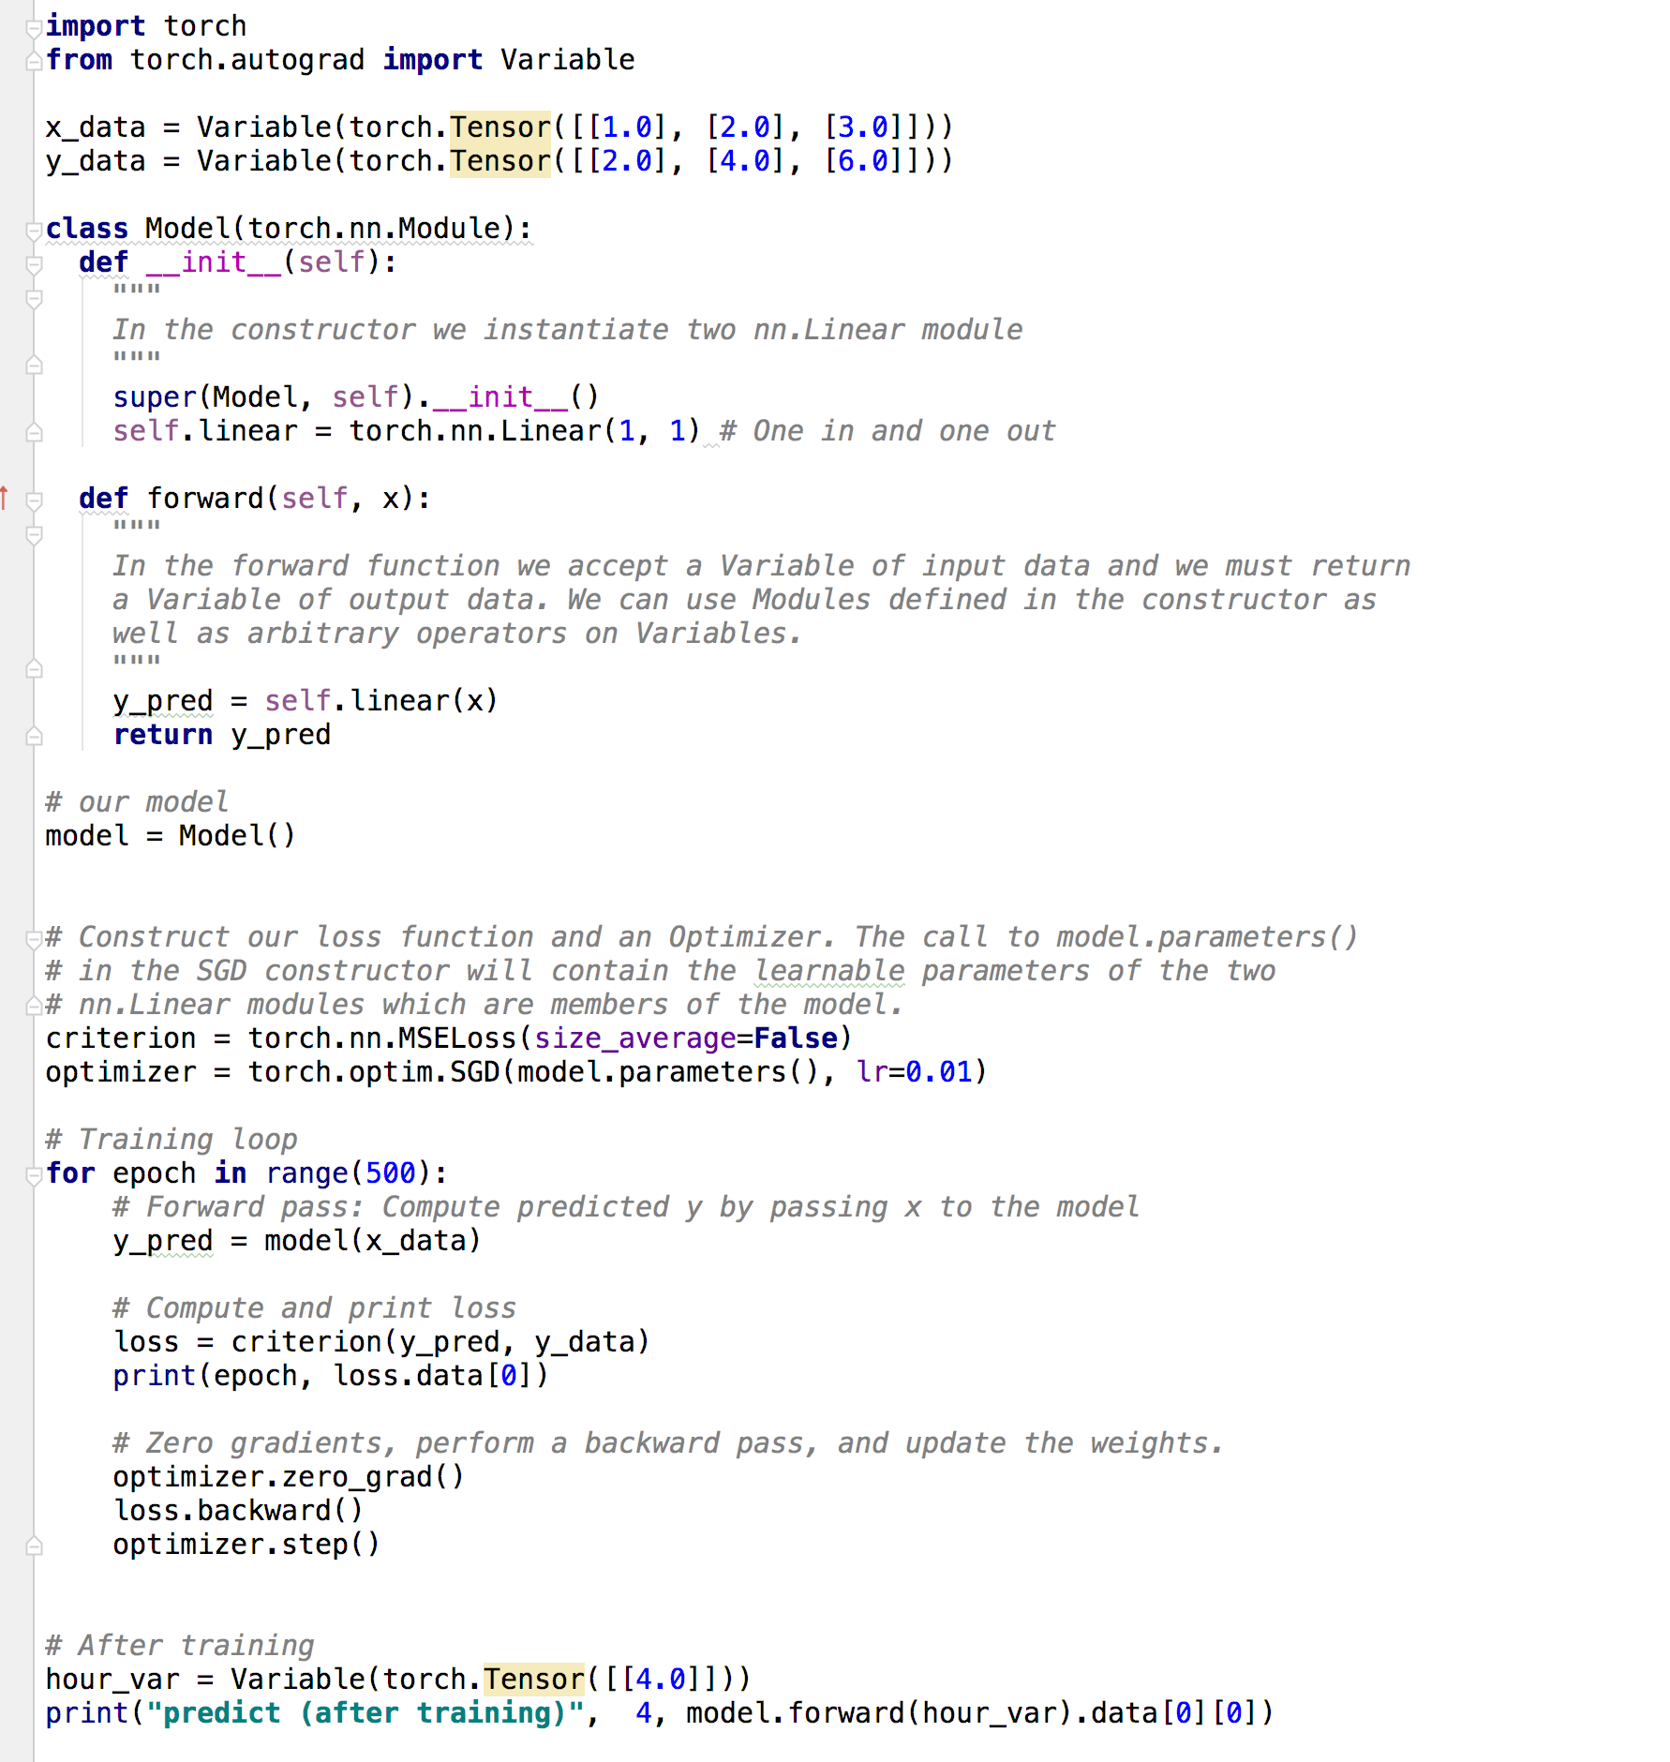

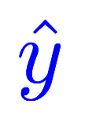
Design your model using class
Linear
Construct loss and optimizer
(select from PyTorch API)
Training cycle
(forward, backward, update)

Slide 14
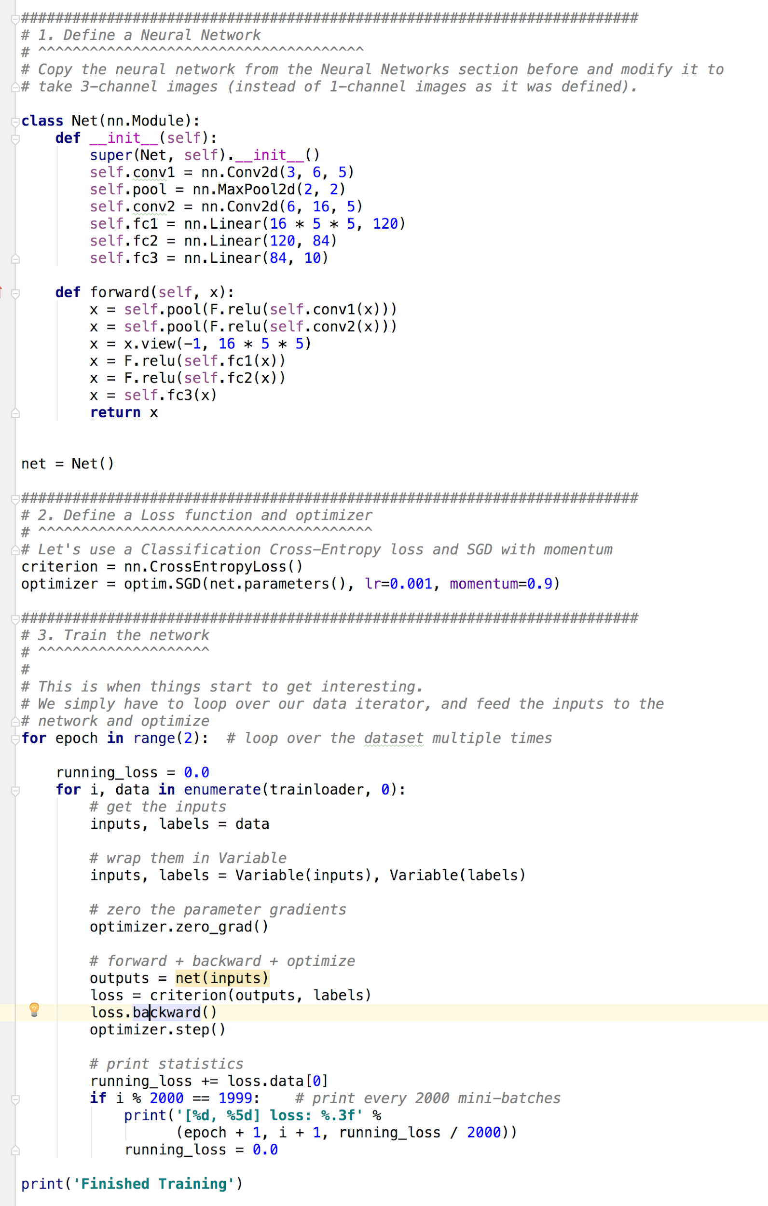
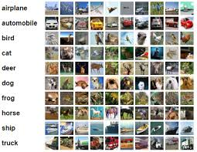
Training CIFAR10 Classifier
http://pytorch.org/tutorials/beginner/blitz/cifar10_tutorial.html

Slide 15
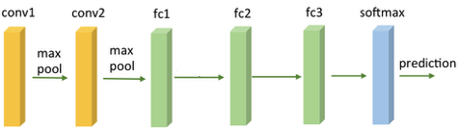
Training CIFAR10 Classifier
Design your model using class
Construct loss and optimizer
(select from PyTorch API)
Training cycle
(forward, backward, update)
http://pytorch.org/tutorials/beginner/blitz/cifar10_tutorial.html

Slide 16
Exercise 5-1: Try other optimizers
torch.optim.Adagrad
torch.optim.Adam
torch.optim.Adamax
torch.optim.ASGD
torch.optim.LBFGS
torch.optim.RMSprop
torch.optim.Rprop
torch.optim.SGD
http://pytorch.org/docs/master/optim.html#algorithms

